Slide 1

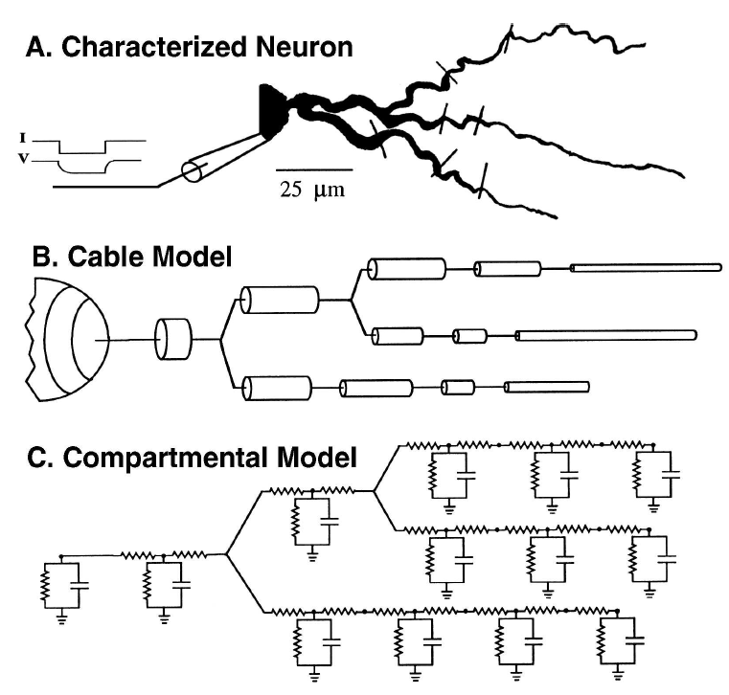
Cable theory
Cable theory is concerned with how inputs propagate to the soma or the axon initial segment, how these inputs interact with one another, and how the placement of an input on a dendritic tree affects its functional importance to the neuron.

Slide 2
Where can you find the details?
Find Neuronal Morphologies in NeuroMorpho
http://neuromorpho.org/
Find neuron’s electrophysiological properties
http://neuroelectro.org/
Allen Institute
http://portal.brain-map.org/
Blue Brain Portal
https://portal.bluebrain.epfl.ch/
Find models in ModelDB
https://senselab.med.yale.edu/modeldb/
Choose your channels using IonChannelGenealogy
https://icg.neurotheory.ox.ac.uk/

Slide 3
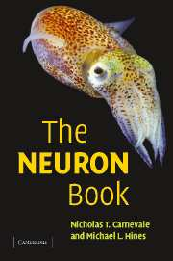
The NEURON simulation environment
NEURON is a simulation environment for models of individual neurons and networks of neurons that are closely linked to experimental data.
Documentation:
https://www.neuron.yale.edu/neuron/static/new_doc/index.html
Neuron with Python
from neuron import h, gui

Slide 4
The main features of NEURON
Graphical User Interface (GUI)
Two programming languages:
1. NMODL (MOdel Description Language->MODL)
Ion channel mechanisms (Hodgkin-Huxley-like kinetics, calcium-dependent kinetics, synaptic properties and others).
2. All other operations in NEURON are performed using scripts written in HOC (High Order Calculator).

Slide 5
The main features of NEURON
Defining the anatomical and biophysical properties of models of neurons and neuronal networks,
Controlling simulations etc.,
e.g.
soma=h.Section(name='soma')
soma.diam=10 #μm
soma.L=3.18 #μm

Slide 6
Distributed (or Density) Mechanisms in hoc
Properties that are distributed over the cell surface (e.g. membrane capacitance, active and passive ionic conductances) or throughout the cytoplasm (e.g. buffers).
e.g.
soma=h.Section(name='soma')
soma.diam=10 #μm
soma.L=3.18 #μm
soma.cm=1 #membrane capacitance, μF/cm²
soma.Ra=100 #axial resistance, ohm cm
soma.insert('hh') #HH channels

Slide 7
Point Processes in hoc
Synapse or electrode for passing current (current clamp or voltage clamp) is represented by a point source of current which is associated with a localized conductance.
Syntax:
varname = h.Classname(section_name(x))
varname.attribute = value

Slide 8
Point Processes in hoc
Example 1
Current clamp
ic = h.IClamp(soma(0.5))
ic.del = 100 #ms
ic.dur = 200 #ms
ic.amp = 0.1 #nA
Example 2
Synapse
syn = h.ExpSyn(soma(0.5))
syn.e = 0 #mV
Example 3
NetStim
ns = h.NetStim(0.5)
ns.start = 100 #ms
ns.number = 2
ns.interval = 10 #ms
Example 5
SEClamp
se= h.SEClamp(section(x))
se.dur = 200 #ms
se.amp = -20 #mV
Example 4
NetCon
nc = h.NetCon(source,target, [threshold, delay, weight])

Slide 9
Cable theory
Connecting compartments
child.connect(parent, [0 or 1])
e.g.
dend0.connect(soma(0),0)
Cable theory is concerned with how inputs propagate to the soma or the axon initial segment, how these inputs interact with one another, and how the placement of an input on a dendritic tree affects its functional importance to the neuron.

Slide 10
How inputs propagate / interact
Jupyter notebook: Exc_1a

Slide 11
How inputs interact: Segregation
Jupyter notebook: Ex1b

Slide 12
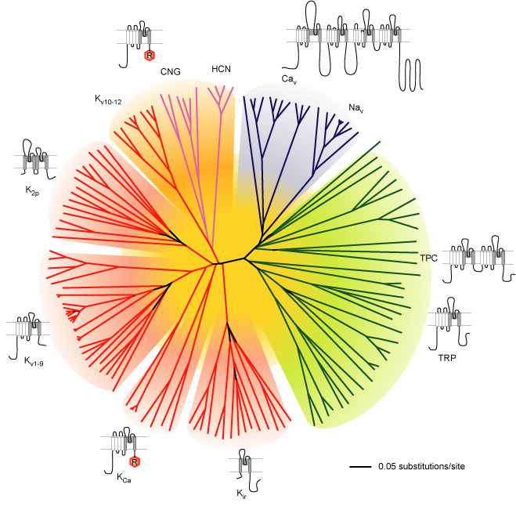
Active mechanisms
Passive ion channels -- no change in permeability due to external factors
Active ion channels -- permeability is dependent upon factors such as:
Membrane potential (e.g., voltage-dependent)
Ionic concentrations (e.g., calcium-dependent)
Ligands (e.g., neurotransmitters)
Which ions matter for neurons?
Yu & Catterall 2003 Science

Slide 13
Are active mechanisms found in dendrites?
Voltage-gated ion channels are prevalent in neuronal dendrites
How do they contribute to active processing?
Migliore & Shepherd 2002

Slide 14
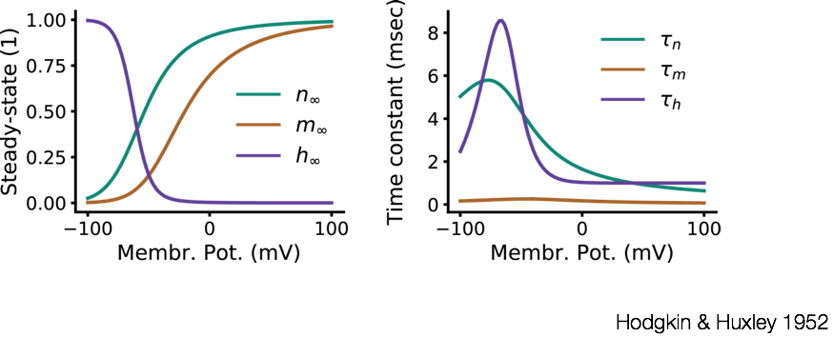
Modelling active conductances

Slide 15
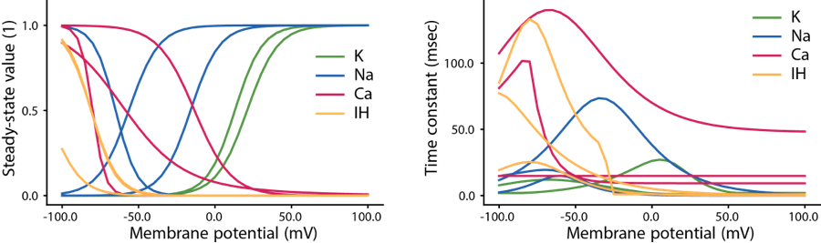
Modelling active conductances
What range of voltages does the channel activate (or inactivate)?
What are the timescales of activation (and inactivation)?
What is the reversal potential of the ionic species?

Slide 16
Modelling active conductances in NEURON
Custom ion channel models are made in separate files with the extension “.mod”
They need to be compiled before the code is run (nrnivmodl / mknrndll)
They must be inserted to each compartment separately (with separate parameters)
The NEURON block:
SUFFIX: the name of the mechanism
USEION / NONSPECIFIC_CURRENT statement: specifies which ionic species the model uses
RANGE variables: can be accessed from hoc / python code (e.g., gbar)

Slide 17
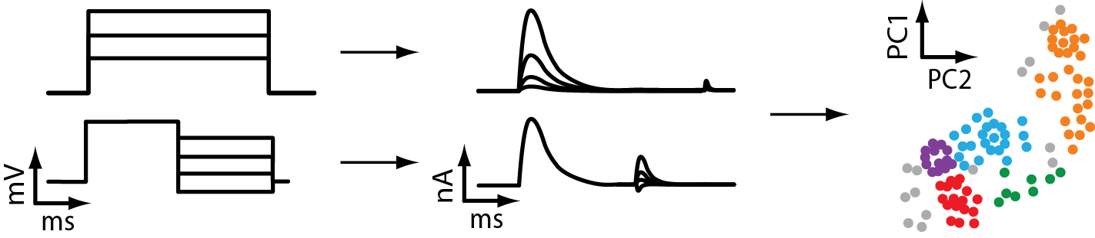
ICGenealogy: a resource for biophysical neuron modelling
Contains nearly 4000 published voltage-gated ion channel models coded in NEURON
Metadata information: subtype, neuron type, brain area, …
Quantitative analysis and comparison of models
https://icg.neurotheory.ox.ac.uk/
Podlaski*, Seeholzer* et al. 2017 eLife

Slide 18
Functional roles of active mechanisms
What active processes occur in dendrites?
What functional roles do they have?
Hausser, Spruston & Stuart 2000

Slide 19
Functional roles of active mechanisms
London & Hausser 2005

Slide 20
How inputs interact: Active Integration
Jupyter notebook: Ex1c

Slide 21
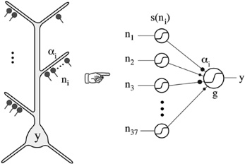
How inputs interact: Spatial Summation
Poirazi et al. 2003
Tran-Van-Minh et al. Front. Cell. Neuroscience, 2015
Which is the best strategy for maximum depolarization – scatter inputs to many dendrites or cluster them into one?

Slide 22
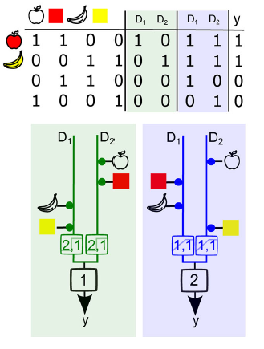
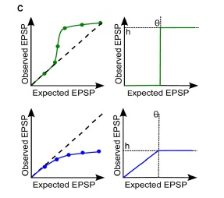
Spatial Summation & Feature Binding problem
Tran-Van-Minh et al. Front. Cell. Neuroscience, 2015

Slide 23
Active Mechanisms in the Dendrites
London & Hausser 2005

Slide 24
Active Mechanisms in the Dendrites
Jupyter notebook:
Exc_2a
Migliore & Shepherd 2002

Slide 25
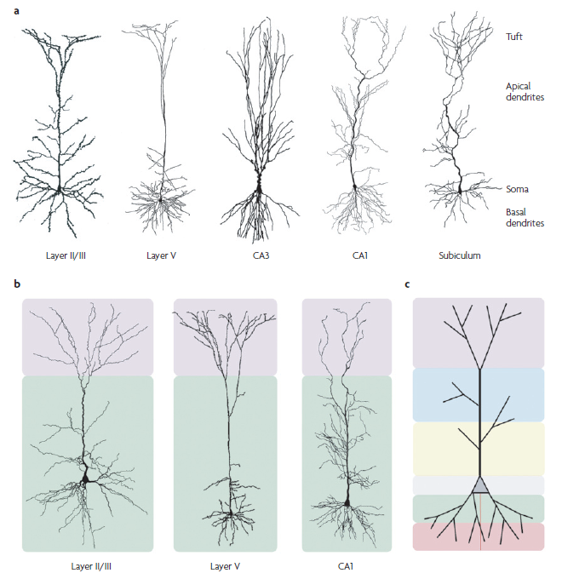
Focusing on the cortex: The pyramidal neuron
(also hippocampus and amygdala)
…display area and region related morphological variability and…
Spruston, Nature Reviews, 2008
Apical tree
Apical tuft
…dendritic domains
that receive unique synaptic inputs.
Apical trunk
Oblique apical dendrites
Basal tree

Slide 26
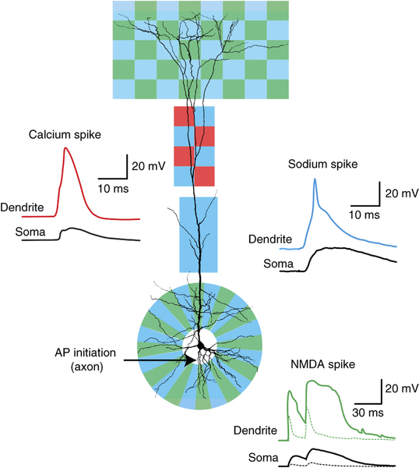
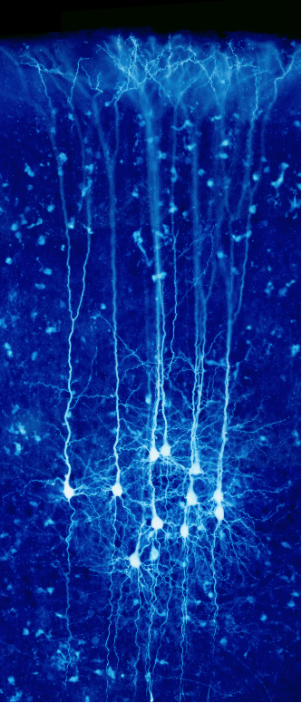
Focusing on the cortex: The pyramidal neuron
Stuart, Spruston, Nature Reviews, 2015
Human brain project

Slide 27
Functional importance: Coincidence detection
Larkum, TINS 2013

Slide 28
Functional importance: Coincidence detection

Slide 29
Functional importance: Coincidence detection
Jupyter notebook: Ex3 – BAC model

Slide 30
More active dendrites: gating plasticity
Jupyter notebook: Exc_2b

Slide 31
Thank you!

Slide 32
One issue to consider… The spatial grid
Computing the values of spatiotemporally continuous variables over a set of discrete points in space (a "grid" of "nodes") for a finite number of instants in time.
Although the time scale of biophysical processes may suggest a natural Dt, it is usually not clear how fine the spatial grid should be.
Section
Compartment
(Segment)

Slide 33


One issue to consider… The spatial grid
The d_lamda rule
$$λ_{f}≈\frac{1}{2}\sqrt{\frac{d}{(πfR_{a}C_{m})}}$$
$$λ=\sqrt{{2dR}_{m}/R_{a}}$$
Example:
diameter=0.5μm, Rm = 50.000 Ω cm², Ri = 100 Ω cm, and Cm =1 μf/cm²
λ_{dc}=1500μm
λ_{f}=200μm
Maximum distance between two grid points=
d_lambda*λ_{AC}, d_lamda=0.1

